Slide 1

FPGA Design Challenge :Techkriti’14 Digital Design using Verilog – Part 1
Anurag Dwivedi

Slide 2
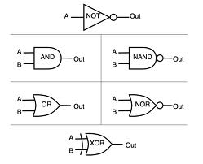
Digital Design : Bottom Up Approach
Basic Block - Gates

Slide 3
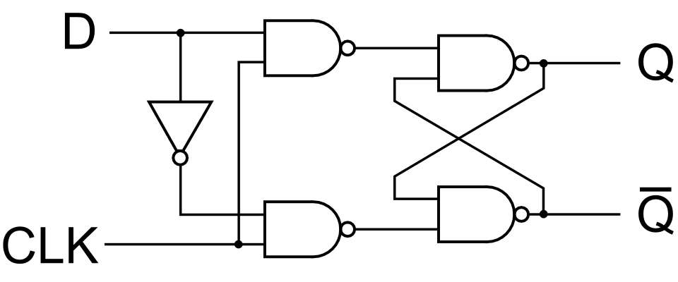
Digital Design : Bottom Up Approach
Gates -> Flip Flops

Slide 4
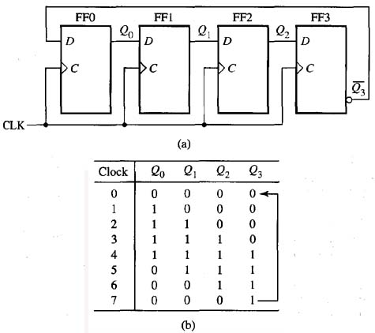
Digital Design : Bottom Up Approach
Flip Flops-> Counter

Slide 5

Digital Design : Bottom Up Approach
Finally a processor can be designed from basic building blocks

Slide 6
HDLs : Motivation
How do we design the circuit? Do we draw it on pen and paper?
Became tedious when the number of gates increased exponentially !
Hardware Descriptive languages (HDLs) comes to the rescue.
We describe the digital circuits in terms of its structure and functionality.

Slide 7
Verilog
Verilog is A Hardware Descriptive Language used to describe a circuit.
Syntax is similar to C, but is not a programming language
Synthesized ( analogous to compiled in C ) to give the circuit logic diagram
VHDL is another HDL commonly used

Slide 8
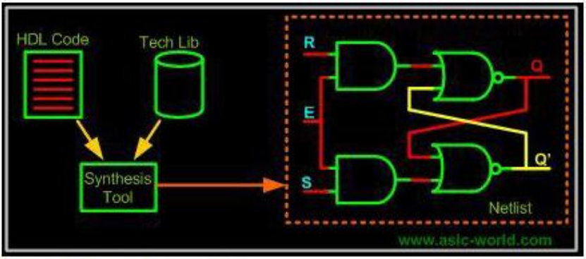
Synthesis of Verilog

Slide 9
FPGA
Field Programmable Gate Array
A fully configurable IC
FPGAs contain programmable logic components called logic blocks.
Hierarchy of reconfigurable interconnects that allow the blocks to be wired together.
FPGA can be made to work as a XOR gate, a Counter or even bigger- an entire Processor!

Slide 10
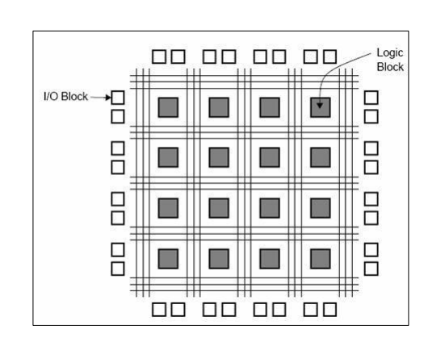
FPGA : Logic Blocks

Slide 11
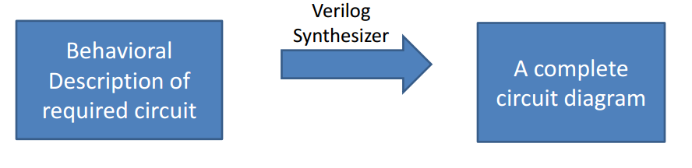
Programming FPGA
Configured using a Hardware Descriptive Language
Can be configured in any way by the user

Slide 12
Coding in Verilog
Consists of various building blocks called Modules
Communication between a module and its environment is achieved by using Ports
Ports are of three types: input, output, inout

Slide 13
Module
A “Black Box” in Verilog with inputs, outputs and internal logic working.
So, a module can be used to implement a counter.
A module is defined as module <specific type>(<port list>);

Slide 14
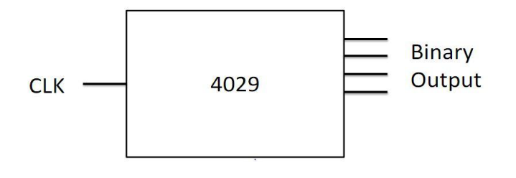
4029 Counter
One Input port for CLK
Four binary output ports
At every rising edge of clock, increment output by 1

Slide 15
Declaring Module
Way 1:
module 4029(clk, a, b, c, d, reset, enable);
//Assuming two more input pins, reset and
//enable with their corresponding functioning
Way 2:
module 4029(clk, out, reset, enable);
What is the difference in the two?

Slide 16
Declaring Ports
Way 1:
input clk;
input reset;
input enable;
output a,b,c,d;
Way 2:
input clk;
input reset;
input enable;
output [3:0] out;

Slide 17
Types of Ports
We need drivers for this module in order to interact with other modules
Driver is a way of defining something which can drive a load
Two types of drivers:
Can store a value (for example, flip-flop)
Cannot store a value, but connects two points (for example, a wire)
In Verilog, a driver which can store a value is called reg and the one which cannot is called wire

Slide 18
Drivers for 4029 modules
Ports defined as wires?
clk
reset
enable
We do not need to stores the values of these ports in our logical block.
Ports defined as reg?
a,b,c,d
out
We need to store them so that we could modify their values when required.

Slide 19
Defining drivers for 4029
Way 1:
wire clk;
wire reset;
wire enable;
reg a,b.c,d;
Way 2:
wire clk;
wire reset;
wire enable;
reg [3:0] out;

Slide 20
Complete definition of module
module 4029( clk, out, reset, enable);
input wire clk;
input wire reset;
input wire enable;
output reg [3:0] out;
endmodule

Slide 21
Wire Vs Reg
reg can store a value, wire simply connects
Most of the times, inputs are wire and outputs are reg
Output of flip flop – wire or reg ?
Output of XOR gate – wire or reg ?
Output of multiplexer – wire or reg ?

Slide 22
What now?
We have seen how to define the outer structure of the modules we will use.
Time to define the internal structure and functioning?

Slide 23
Operational and Conditional Statements
All the arithmetic as well as logical operators in Verilog are similar to C, except ++ and –- which are not available in Verilog.
Conditional statements are also similar to C with following modifications:
{ is replaced by begin.
} is replaced by end.

Slide 24
Combinatorial Circuits
Combinational circuits are acyclic interconnections of gates.
And, Or, Not, Xor, Nand, Nor ……
Multiplexers, Decoders, Encoders ….
Adders, Multipliers ….
OUTPUT DEPENDS ON THE PRESENT INPUT ONLY.
How are these gates, muxs etc. abstracted in Verilog?
Gates, Add, Multiply … : by simple operators like in C
Multiplexers … : by control statements like if-else, case, etc.
Gate level implementation of above high level operators done by Verilog synthesizer.

Slide 25
Control Statements
if-else, case :
Exactly like C.
Hardware view: implemented using multiplexers
for loops, repeat:
– for-loops are synthesizable only if length of iteration is determined at compile time & finite.
repeat -similar to for loop.
Hardware view: All loops are unrolled during synthesis.

Slide 26
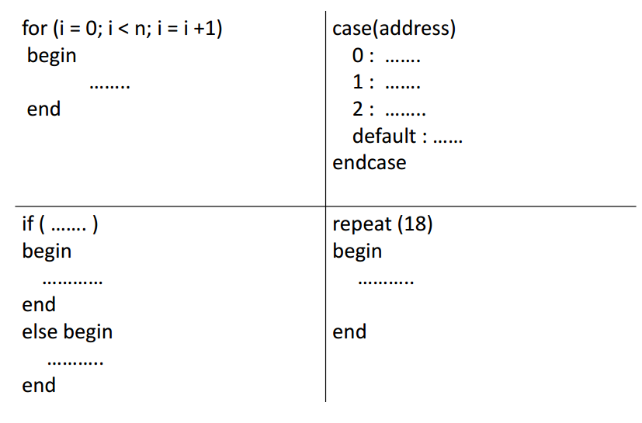
Control Statement Syntax

Slide 27
Assign statements
Continuous assignment statement.
Used for modeling only combinational logic.
module BusInverter( input wire A, output wire B );
assign B = ~A;
endmodule
Basically B is shorted to ~A.
RHS should have variable of wire type.

Slide 28
Example-1 bit Full Adder
module full_adder(
input wire a,
input wire b,
input wire cin,
output wire sum,
output wire carry );
assign sum = a & ~b & ~cin | ~a & b & ~cin |~a & ~b & cin | a & b & cin;
assign carry = a & b | a & cin | b & cin;
endmodule
module full_adder(
input wire a,
input wire b,
input wire cin,
output wire sum,
output wire carry );
assign { carry, sum } = a+b+cin;
endmodule
Gate Level Description
Behavioral Description

Slide 29
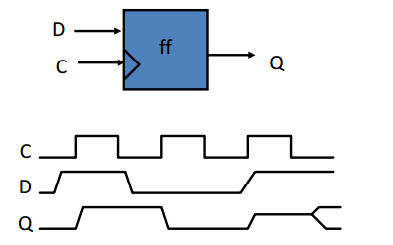
Sequential Circuits
Circuits containing state elements are called sequential circuits
OUTPUT DEPENDS ON THE PRESENT INPUT AS WELL AS ON ITS PRESENT STATE.
The simplest synchronous state element: Edge triggered D Flip Flop
How do you implement such an element in Verilog?

Slide 30
always @ block
It is an abstraction provided in Verilog to mainly implement sequential circuits.
Also used for combinational circuits.
always @(#sensitivity list#)
begin
………. //No assign statements inside always@
end
Execution of always block depends on the sensitivity list.

Slide 31
Sensitivity List
Run continuously. (mostly used in Test Benches)
always
Run when any variable changes its value.
always @(*) //for combinational ckts
Run when the variables `a' or `b' change their value.
always @(a, b)
Run when a positive edge is detected on CLK.
always @(posedge CLK) //for sequential ckt

Slide 32
initial block
An initial block is executed only once when simulation starts
This is useful in writing test benches
If we have multiple initial blocks, then all of them are executed at the beginning of simulation

Slide 33
Counter Example
module Counter(
input wire CLK,
output reg [3:0] OUT );
initial
OUT <= 0;
always @(posedge CLK)
OUT <= OUT + 1;
endmodule

Slide 34
Blocking and Non-blocking statement
Non-blocking assignments happen in parallel.
always @ ( #sensitivity list # ) begin
B <= A ;
C <= B ; // (A,B) = (1,2) -> (B,C) = (1,2)
end
Blocking assignments happen sequentially.
always @ ( #sensitivity list # ) begin
B = A ;
C = B ; // (A,B) = (1,2) -> (B,C) = (1,1)
end

Slide 35
Points to note
Use always@(*) block with blocking assignments for combinational circuits.
Use always@(posedge clk) block with non- blocking assignments for sequential combinational circuits.
Do not mix blocking and non-blocking statements.

Slide 36
Complete 4029 module
module 4029( clk, out, reset, enable);
input wire clk;
input wire reset;
input wire enable;
output reg [3:0] out;
always @(posedge clk)
begin
if (reset == 0 && enable == 0)
begin
out <= out +1;
end
end
// continued to next page

Slide 37
Complete 4029 module
always @(reset or enable)
begin
if (reset == 1’b1)
begin
out <= 0;
end
end
endmodule

Slide 38
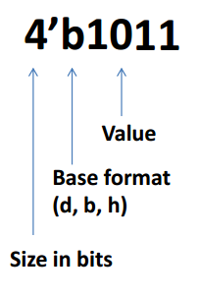
Extras : bit literals
If no size given, number is assumed to be 32 bits.
If <size> is smaller than value
MSB of value truncated
If <size> is greater than value
MSB of ‘value’ filled with zeros
e.g. - hexadecimal: 4’hB
If no base given, number assumed to be decimal. e.g. - 11

Slide 39
For Tommorrow
Modular Circuits
Test Benches
Demonstration
Problem Statement Discussion

